Slide 1
C/C++ Workshop
By second year BUas student
Sam Boots

Slide 2
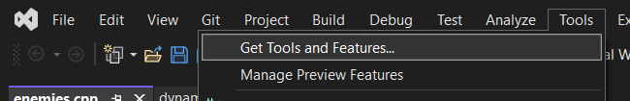
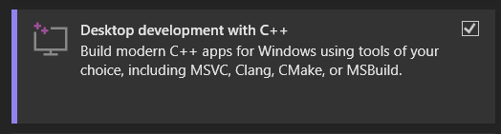
Before we start, install needed packages
Install Desktop development with C++.
For now we will use visual studio 2019/2022, but older versions are also fine
Use something else? Look at how you can get C++ to work on there.

Slide 3
Text based RPG
A tiny RPG where we will learn these concepts:
Static and Dynamic arrays in C++.
Pointers and memory.
Headers(.h) and cpp(.cpp) files.
In addition, if you want to do extra:
Linked Lists
Polymorphism in C++.

Slide 4
Introduction
About the Speaker
Why C++?
Assignment
Quiz
Pointers and memory
Assignment
Classes
Assignment
End

Slide 5
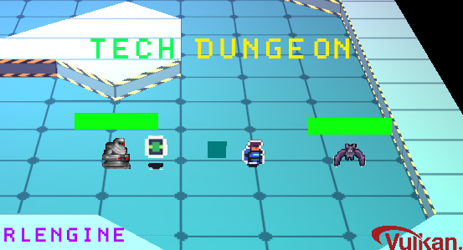
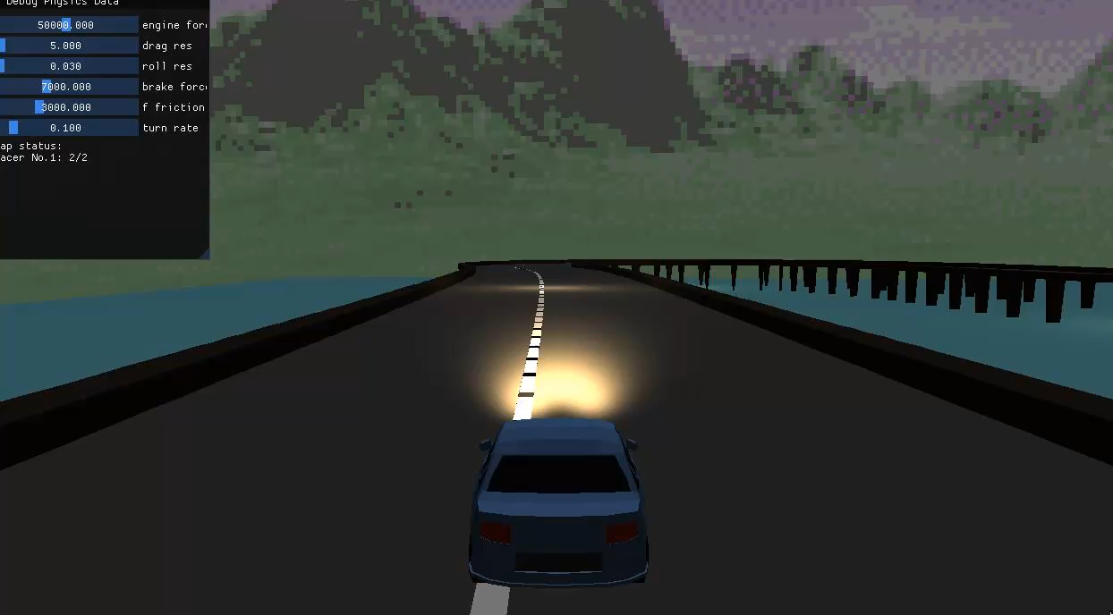
Speaker
Sam Boots
Second Year student at Breda University of Applied Sciences
Sint Lucas graduate 2020
Coding for 6 years, C++ for 2.

Slide 6
Why C++? The Good
Lot of control.
Low-Level (Middle-Level)
Direct memory management
STL (Standard Template Library)
Statically Typed Language
Large Community
High-Level features
High Demand

Slide 7
Why C++? The Bad
Lot of control, to mess up.
Low-Level (Middle-Level)
Direct memory management
Lack of Garbage Collector
STL (Standard Template Library)
High-Level features with security issues.
More code for less result.

Slide 8
Assignment
Make an array of integers with a size of 10.
The integers are a random integer that ranges from -100 to 100.
Iterate through the array and print the integers
BONUS: Make your own random function.

Slide 9
Quiz
How many bytes is an Int
How many bytes is a float?
Class Data { float x, float y }
How many bytes is struct Data?

Slide 10
Pointers
Address in Memory
Int Pointer
Int value = 0; standard interger
Int* pvalue = &value; this is a pointer value.
Int unreferencedpValue = *pvalue;
Pointer is 8 bytes regardless of type it points to.

Slide 11
new and delete operator
Int* pvalue = new int; allocate a new int on the heap instead of the stack.
delete pvalue; deletes the int from the heap.
Int* pvaluearray = new int[8]; allocate an array of ints.
delete[] pvalue; requires the special delete[] operator to correctly delete from memory

Slide 12
Assignment
Make an array of integers.
Size of the array is random, the size should be around 100-200.
The integers are a random integer that ranges from -100 to 100.
Iterate through the array and print the integers
BONUS: Instead of an array make a Linked list.

Slide 13
Classes
Constructor
Destructor
Struct vs Class
Private and Public

Slide 14
Assignment
Make a class named Enemy
Enemy has hit points, a random value between 10 and 20.
Enemy has damage it can deal, it deals around 2-8 damage.
Enemy has a function that prints its hit points and damage to the console.
Convert the dynamic int array to a dynamic Enemy array.
Iterate through the array and print the enemy’s stats using the function.
BONUS: Give enemies a name and display that alongside its stats.

Slide 15
Assignment
Make an class named Player
Player has hit points, a set value of 30.
Player can also deal damage, it has a damage value of 10.
Player has a function that prints its hit points and damage to the console.
The player can attack an enemy. Reducing the enemy’s health equal to the players damage. Do this in a loop and end it when all enemies are slain.
BONUS: Make a base-class for a character that both Enemy and Player inherit from.

Slide 16
End of Assignments
Now with this basis you can make something simple like a application that responds on your console output for player actions.
I will leave a link to the github page of where I made the same project.

Slide 17
Final Note
C++ is big, programming is gigantic. There is never an end to the things you can learn or specialize in. Find your passion and go for it!
We did not use STL, but I recommend you to research and use it.
Good sources are everywhere, bad sources as well. Be broad in your learning.

